Slide 1
TECHNOLOGICAL INDUSTRIAL RESOLUTION

Slide 2
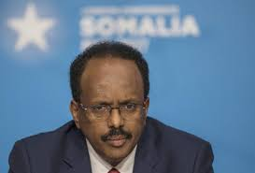
ABDIRAZIK IDO
founder and controlling shareholder of Nation link Telecom one of the largest telecommunications companies in Somalia.

Slide 3
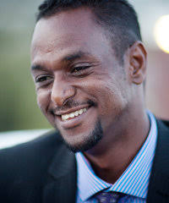
LIBAN ABDI EGAL
founder and Chairman of First Somali Bank

Slide 4

ABDIRASHID DUALE
CEO of Dahabshiil, an international funds transfer company

Slide 5
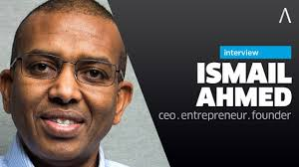
ISMAIL AHMED
WORLDREMIT
online money transfer service that lets people send money to friends and family in other countries.

Slide 6
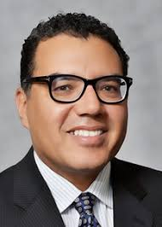
HUSSEIN MOHAMMED
entrepreneur; Vice Chairman of the Eastleigh Business Association

Slide 7
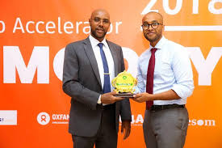
AHMED MOHAMED YUSUF
CEO of Hormuud

Slide 8
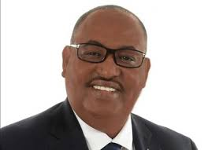
ABDULKADIR ALI
Somali-American entrepreneur and former President of the Somali American Chamber of Commerce

Slide 9
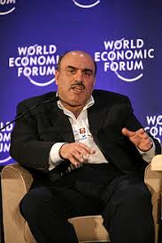
OMARI A ALI
CEO of Dar al-Maal al-Islami (DMI Trust) worth $4.0 billion USD

Slide 10
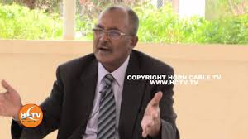
XASUUS REEB
An online wedding and event planning service.

Slide 11

HARGEISA DAILY
A media management software

Slide 12
THANK YOU

